Slide 1
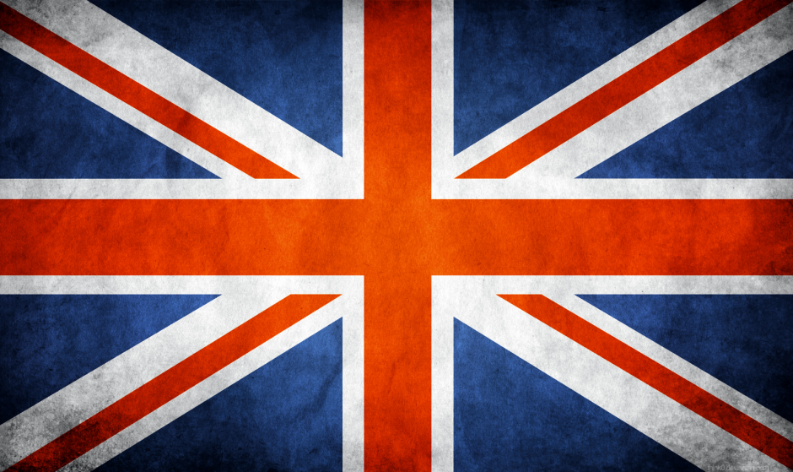
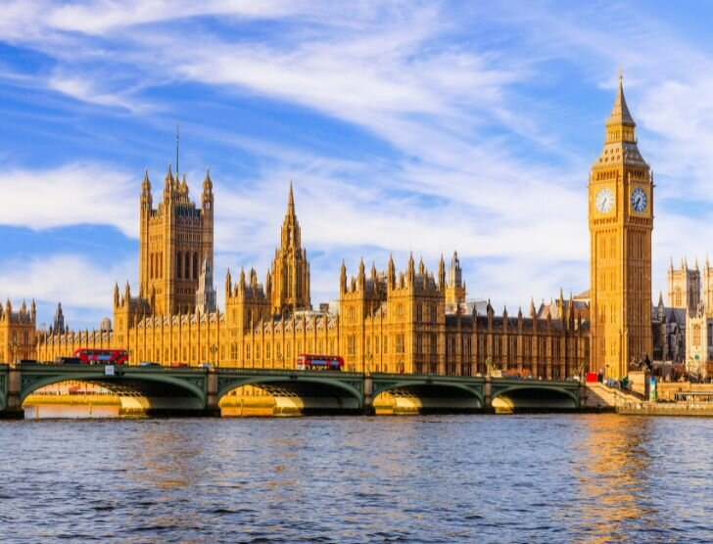
Wielka Brytania

Slide 2
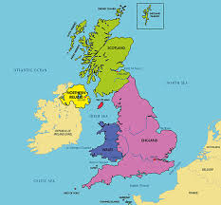
The location of United Kingdom
The United Kingdom is an island nation in Western Europe, encompassing the island of Great Britain to the north and the neighboring island of Ireland to the north. It is separated from continental Europe by the English Channel and the North Sea. The country lies northwest of the European continent and is bordered to the west by the Irish Sea and St. George's Channel, which separate it from Ireland.

Slide 3
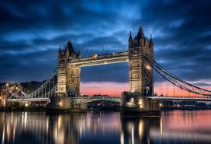
Tower Bridge
The most famous bridge in Great Britain is Tower Bridge in London, a historic tourist attraction and symbol of the city,

Slide 4
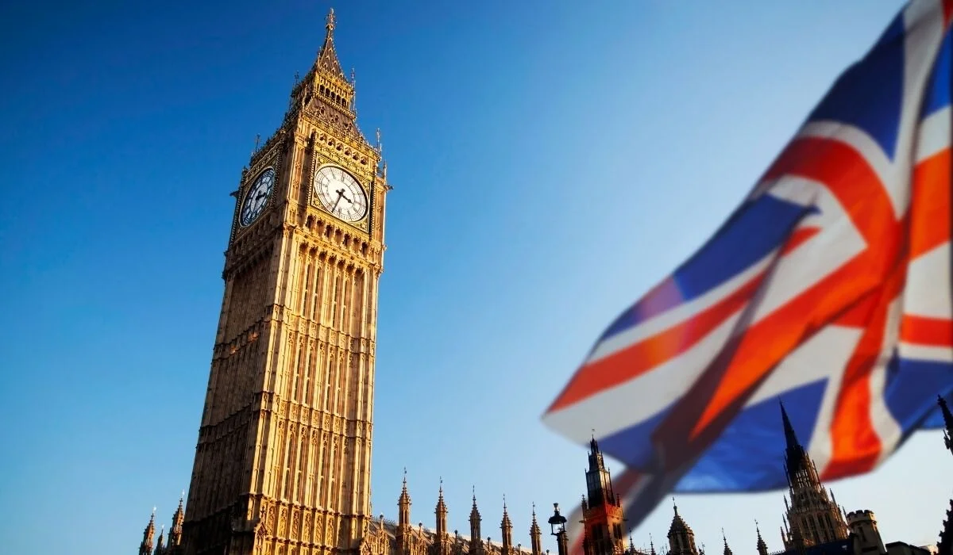
Culture
British culture is characterized by a blend of strong traditions, such as the monarchy and afternoon tea, with an openness to modernity and cultural diversity, as evidenced by multiculturalism and a wide range of religions. The British are known for their distinctive, often sarcastic, sense of humor, and their national identity is based on values ​​such as democracy, the rule of law, and tolerance.

Slide 5
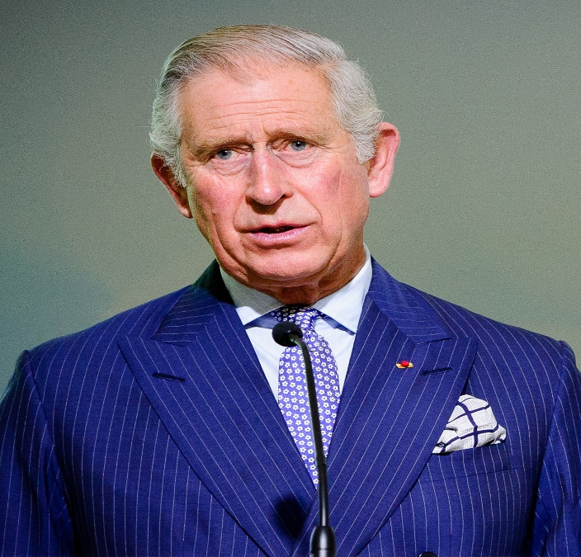
King
Children: William,
Prince of Wales,
Henry Siblings: Andrew,
Anne,
Edward Grandparents:
Queen Elizabeth the Queen Mother,
George VI,
Alice of Battenberg,
Charles III is King of the UnitKingdomed
of Great Britain and Northern Ireland
and 14 other sovereign Commonwealth
realms, including their territories and
dependencies, from 8 September 2022.
He is also Head of the Commonwealth,
Temporal Head of the Church of England,
and Supreme Commander of the
Temporal Head of the Church of England,
and Supreme Commander of
the British Armed Forces.
Date and place of birth: 14 November 1948,
76 years old, Buckingham Palace,
London, United Kingdom
Education: Trinity College (1967–1970),
Cheam School · Show more Height: 1.78 m (5 ft 8 in)
Wife: Camilla (since 2005),
Diana, Princess of Wales (from 1981 to 1996)

Slide 6
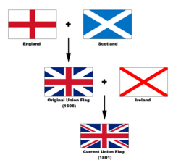
Flag
The flag consists of superimposed symbols of Scotland (the white cross of St. Andrew), England (the red cross of St. George with a white outline), and Ireland (the red cross of St. Patrick, also with a white outline). All placed on a blue background

Slide 7
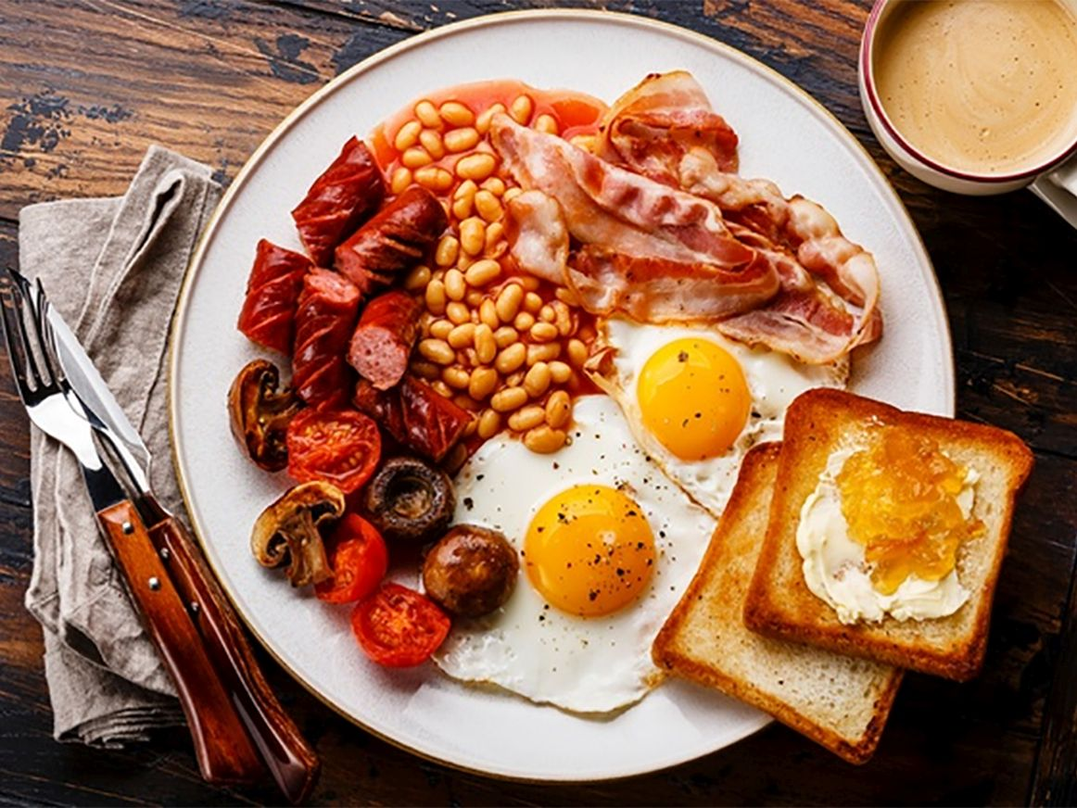
Food
British food is characterized by traditional, often fatty dishes like fish and chips, Sunday roast, and a hearty English breakfast. Popular dishes also include casseroles like Shepherd's Pie, desserts like Apple Pie, and Indian influences like Chicken Tikka Masala. Traditional baked goods like scones for afternoon tea are also worth trying, as are regional specialties like Scottish Haggis and Welsh Cawl.

Slide 8
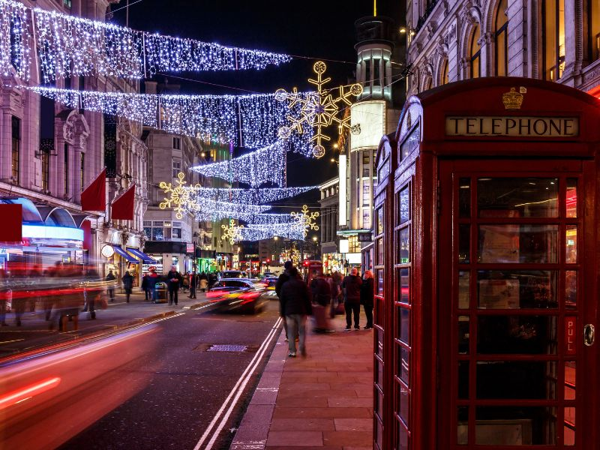
Christmas traditions
Christmas Traditions
Christmas Eve: In the evening, children hang up stockings, in which Santa Claus leaves presents.
Christmas Day: A family dinner with roast turkey and pudding is a tradition.
Sending Christmas cards: Despite advances in technology, sending paper cards is still popular.
Caroling: Similar to Poland, Britons sing carols in homes and public places, often to raise money for charity.
Halloween: Dressing up and trick-or-treating are popular.
Guy Fawkes Night (November 5): Burning an effigy of Guy Fawkes and organizing fireworks displays.
New Year's Eve: Many people celebrate at home, in pubs, or at clubs. First day of the New Year (first footing): The custom of welcoming the first guest into the house, who should bring symbolic gifts such as coal, bread and money.

Slide 9
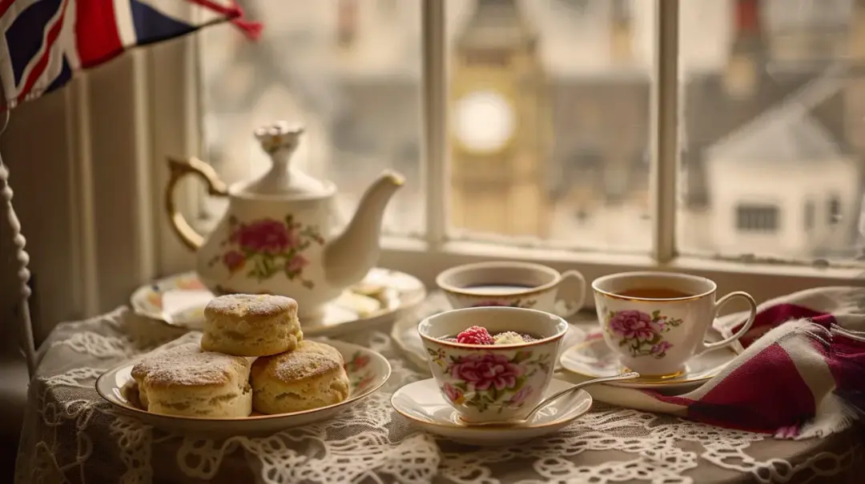
Daily rituals
Daily Rituals and Behaviors
Afternoon Tea: At 5:00 PM, Britons often drink tea, accompanied by a small snack such as biscuits.
English Breakfast: A hearty breakfast consisting of eggs, baked beans, bacon, tomatoes, and sausages.
Pubs: Popular places for socializing, family gatherings, games, and meals.
Queues: The practice of patiently waiting in lines is common in British society.

Slide 10
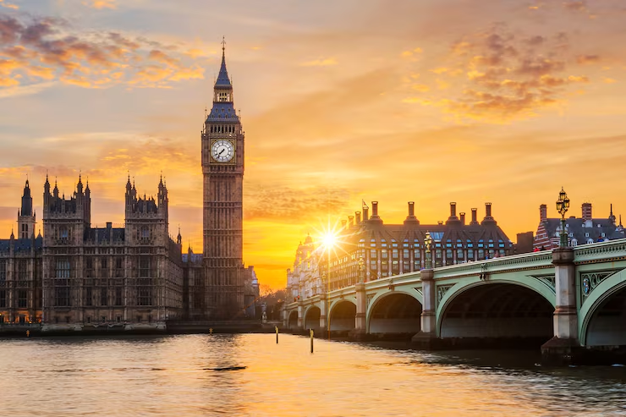
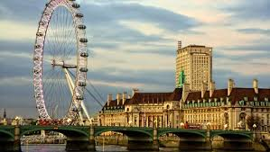
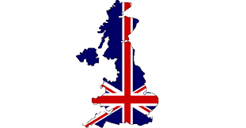
End
Thank you for your attention. The presentation was prepared by: Anna Kutermak, Milena Wawro

